Slide 1

JavaScript: The Language Powering the Interactive Web

Slide 2

What is JavaScript?
Created by Brendan Eich in 1995 at Netscape to make web pages alive and interactive. It revolutionized how users interact with websites.
A lightweight, cross-platform, object-oriented scripting language embedded in browsers. It runs on the client-side, making web experiences more dynamic without constant server requests.
Despite the name, it’s not related to Java; it’s a dynamic, prototype-based language with a distinct purpose and syntax.

Slide 3



Why JavaScript Matters: Applications Everywhere
Interactive Web
Server-Side Logic
Beyond the Web
Runs in browsers to create animations, clickable buttons, and dynamic content, enhancing user engagement.
Powers server-side apps via Node.js for real-time collaboration and complex backend operations.
Used in mobile apps, games, desktop applications, and even IoT devices, showcasing its incredible versatility.

Slide 4
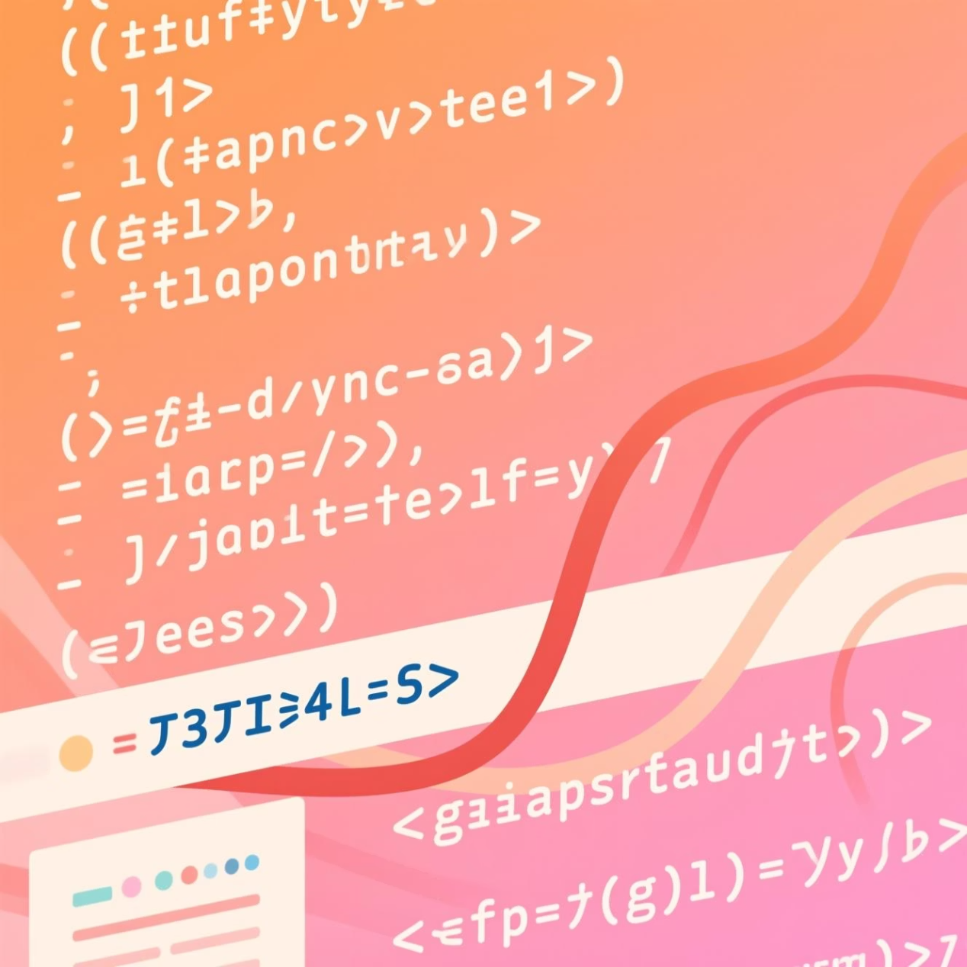
JavaScript Scripts: The Building Blocks
Scripts are plain text programs embedded directly within HTML, executing automatically on page load or specific events.
They enable dynamic page updates without full reloads, leveraging technologies like AJAX and DOM manipulation to create seamless user experiences.
Crucially, scripts react to user events such as clicks, keypresses, and form inputs, making web pages truly interactive and responsive.

Slide 5
Inside the Browser: The JavaScript Engine
Parsing & Compiling
Runtime Optimization
Environment Provider
Engines like Google’s V8 (Chrome), Mozilla’s SpiderMonkey (Firefox), and Apple’s JavaScriptCore (Safari) parse and compile JS into efficient machine code.
These engines continuously optimize code on the fly during execution, ensuring fast performance even for complex applications.
They provide the crucial runtime environment, connecting JavaScript to browser APIs and the Document Object Model (DOM).

Slide 6
How JavaScript Engines Work
01
02
03
Parsing
Compilation
Execution & Optimization

Slide 7



Popular JavaScript Editors & IDEs
Visual Studio Code
WebStorm
Online Editors
A free, lightweight, and highly extensible code editor with robust JS support, integrated debugging, and a vast ecosystem of extensions.
A powerful, intelligent IDE offering advanced features like smart code completion, refactoring, and deep code analysis for large projects.
Platforms like CodePen and JSFiddle are excellent for quick prototyping, testing snippets, and sharing code directly in the browser.

Slide 8
Writing Your First JavaScript Script
Let's walk through a simple example: changing a webpage heading text dynamically with JavaScript.
<!DOCTYPE html><html><head> <title>My First JS Page</title></head><body> <h1 id="myHeading">Hello, World!</h1> <button onclick="changeText()">Click Me!</button> <script> function changeText() { document.getElementById("myHeading").innerHTML = "JavaScript Changed This!"; } </script></body></html>
This script finds an element by its ID and updates its content when the button is clicked, demonstrating basic DOM manipulation.

Slide 9

JavaScript Basics: Syntax, Variables, Data Types & More
Explore the core concepts of JavaScript, the powerful language that brings dynamic interactivity to the web. This presentation will cover the fundamental elements of JavaScript, from its basic syntax to how it manages data, providing essential knowledge for every aspiring developer.

Slide 10



Syntax & Variables: The Building Blocks
JavaScript's syntax is familiar to developers with a background in C-style languages, featuring case-sensitivity and the common use of semicolons (though often optional in modern practice). Variables are fundamental containers for data, and JavaScript offers three primary keywords for declaration, each with distinct scoping and mutability rules.
var
let
const
The original keyword for declaring variables, with function-level scoping. Often leads to unexpected behavior due to hoisting.
Introduced in ES6, providing block-level scope. Variables declared with let can be reassigned but not redeclared in the same scope.
Also introduced in ES6, for declaring constants with block-level scope. Once assigned, the value of a const variable cannot be reassigned.
Example Syntax:
let greeting = "Hello, World!";const PI = 3.14159;var oldWay = 10;

Slide 11

JavaScript Essentials: Operators
Welcome to a foundational dive into JavaScript. This presentation will guide you through the essential concepts of operatorsempowering you to write more dynamic and efficient code.

Slide 12

Operators: The Building Blocks of Expressions
Operators are special symbols or keywords that perform operations on one or more values (operands). They are fundamental to creating any meaningful expression in JavaScript, allowing you to manipulate data and control program flow.
Arithmetic operators: Perform mathematical calculations.+ (addition), - (subtraction), * (multiplication), / (division), % (modulus for remainder), ** (exponentiation).
Increment/decrement: Conveniently increase or decrease a variable's value by one.++ (increment), -- (decrement).
Comparison operators: Compare two values and return a boolean (true or false).=== (strict equality, checks value and type), !== (strict inequality), > (greater than), < (less than), >= (greater than or equal to), <= (less than or equal to).
Example:
let x = 10;
let y = 5;
// Arithmetic
let sum = x + y; // 15
let product = x * y; // 50
// Incrementx++; // x is now 11
// Comparison
let isEqual = (x === 11); // true
let isGreater = (y > x); // false
Understanding operators is crucial for writing logical and effective JavaScript code.

Slide 13

JavaScript Arrays and Loops: Mastering Data and Repetition
Unlock the power of efficient data handling and automated repetition in JavaScript. This presentation explores the fundamental concepts of Arrays and Loops, demonstrating how they work together to build dynamic and robust applications.

Slide 14
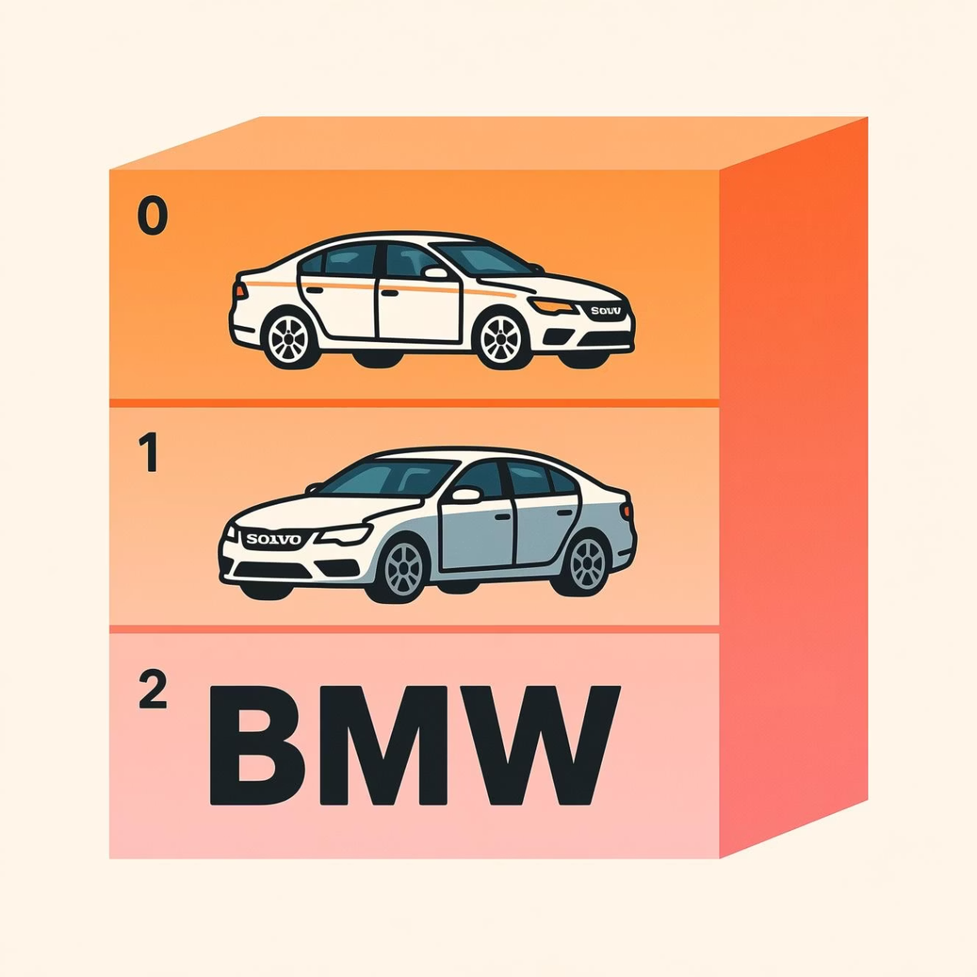
Why Arrays? Handling Many Values Efficiently
Arrays serve as versatile containers, allowing you to store multiple values under a single variable name. Each value is accessed via an index, with the first element always at index 0. This efficient organization is crucial for managing collections of related data.
For example, const cars = ["Saab", "Volvo", "BMW"]; neatly groups three car names. Arrays are incredibly flexible, capable of holding diverse data types like strings, numbers, objects, and even other arrays, making them a cornerstone of JavaScript programming.

Slide 15
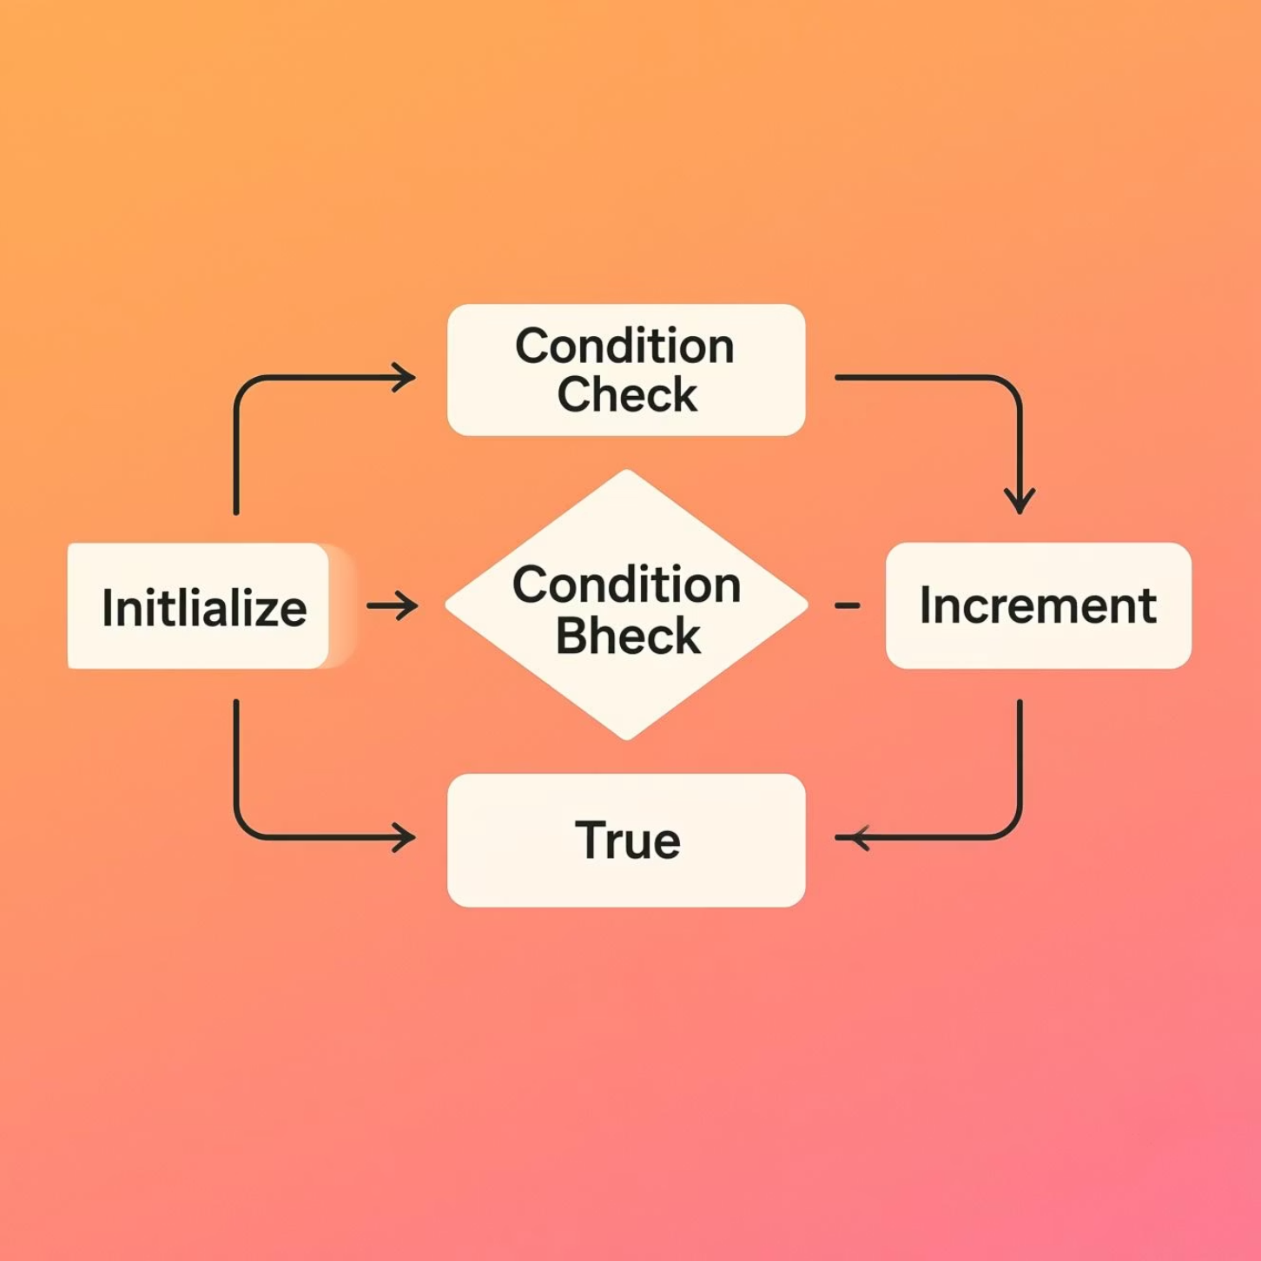
Loops: Automate Repetition in Code
Loops are control flow statements designed to execute a block of code multiple times. They are indispensable for tasks that involve iterating over collections of data, such as processing each item in an array or repeating an action a specified number of times.
Two common types include the traditional for loop, offering precise control over iteration, and the more modern for...of loop (ES6+), which simplifies iteration over iterable objects like arrays. Whether counting selected options in a list or printing every element, loops streamline your code and enhance efficiency.

Slide 16
Combining Arrays & Loops: Practical Example
One of the most powerful applications of loops is their ability to interact with arrays, allowing for batch processing, transformation, and analysis of data. Let's look at a simple example: adding the word " rock" to each animal name in an array.
Initial Array
Using a `for` loop
Resulting Array
const animals = ["cat", "dog", "bird"];
for (let i = 0; i < animals.length; i++) { animals[i] = animals[i] + " rock";}
["cat rock", "dog rock", "bird rock"]
This demonstrates how loops enable dynamic modification and processing of array elements, a core skill for any JavaScript developer.

Slide 17

Understanding the JavaScript DOM: Representation, Properties, Structure & Types
This presentation will demystify the JavaScript Document Object Model (DOM), explaining its core concepts, how it represents web documents, and how developers interact with it to create dynamic and interactive web experiences.

Slide 18



What is the DOM?
Programming Interface
Tree of Objects
Dynamic Capabilities
The Document Object Model (DOM) acts as a cross-platform, language-independent programming interface for web documents.
It represents the HTML page as a logical tree of objects (nodes), allowing JavaScript to access and manipulate its content.
The DOM enables dynamic changes to the structure, style, and content of web pages in real-time after they have been loaded.

Slide 19
DOM Representation: The Tree of Nodes
The DOM transforms the linear HTML code into a hierarchical tree structure, where each part of the document becomes a distinct node. This visual model is fundamental to understanding how to navigate and modify web content programmatically.
Hierarchical Model
Element Nodes
The DOM models the entire document as a hierarchical tree of objects, reflecting the nested nature of HTML.
Each HTML tag (e.g., <div>, <p>, <a>) is converted into an element node in the DOM tree.
Text Nodes
Root and Children
The actual text content within HTML tags becomes distinct text nodes, which are always leaf nodes in the tree.
The <html> tag serves as the root node, with <head> and <body> typically being its primary child nodes.

Slide 20
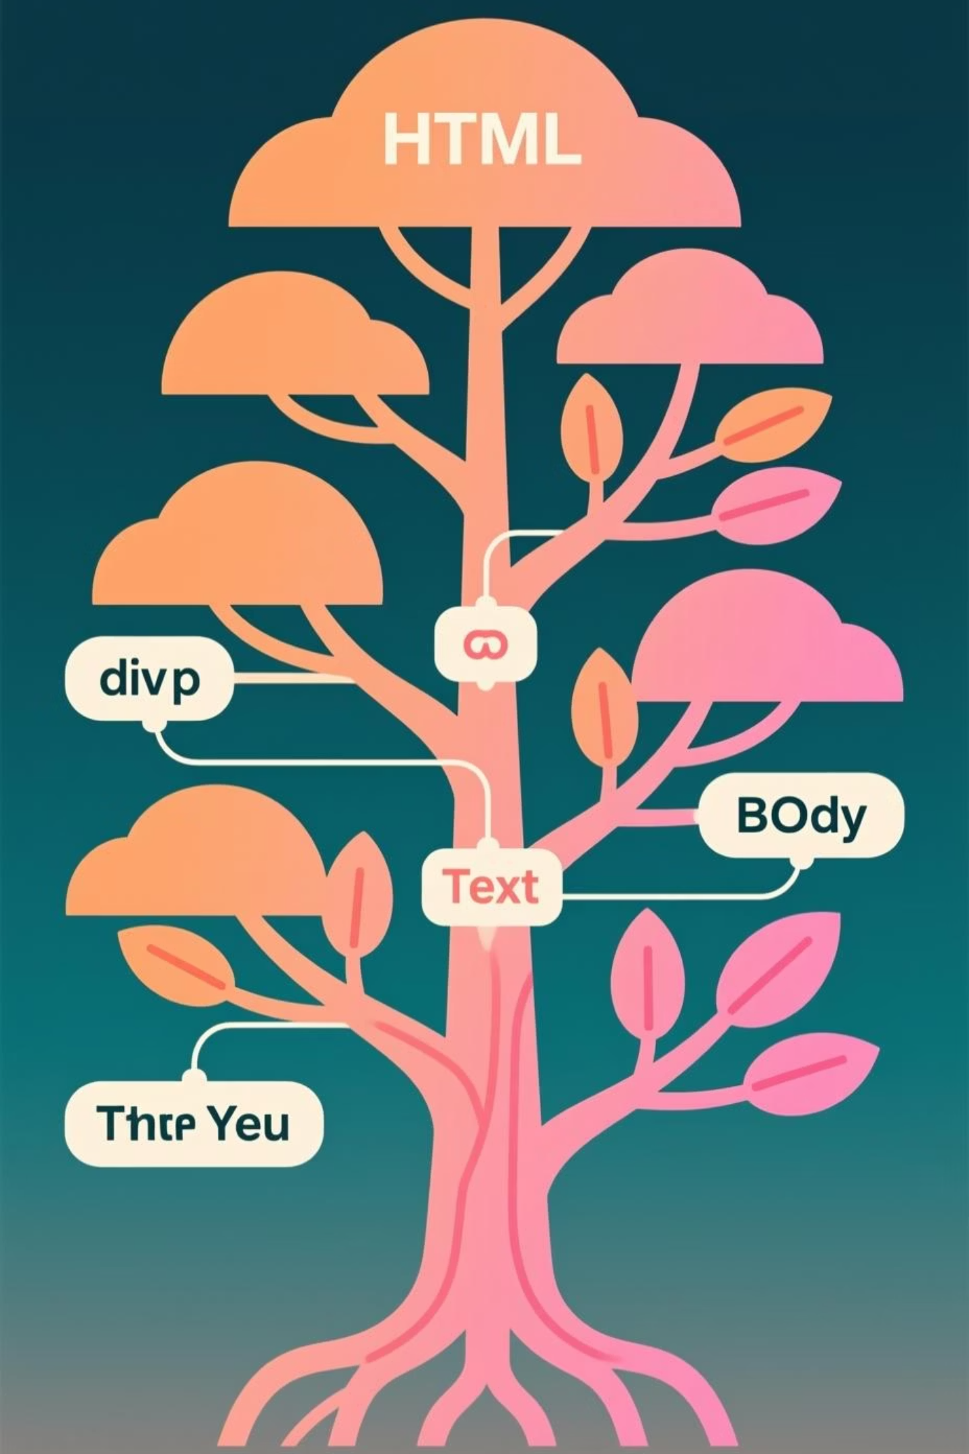
Visualizing the DOM Tree
Root: The <html> element forms the very top of the tree.
Branches: <head> and <body> extend from the root, leading to further nested elements.
Leaves: Text nodes containing strings are always at the end of a branch, representing the actual content.

Slide 21
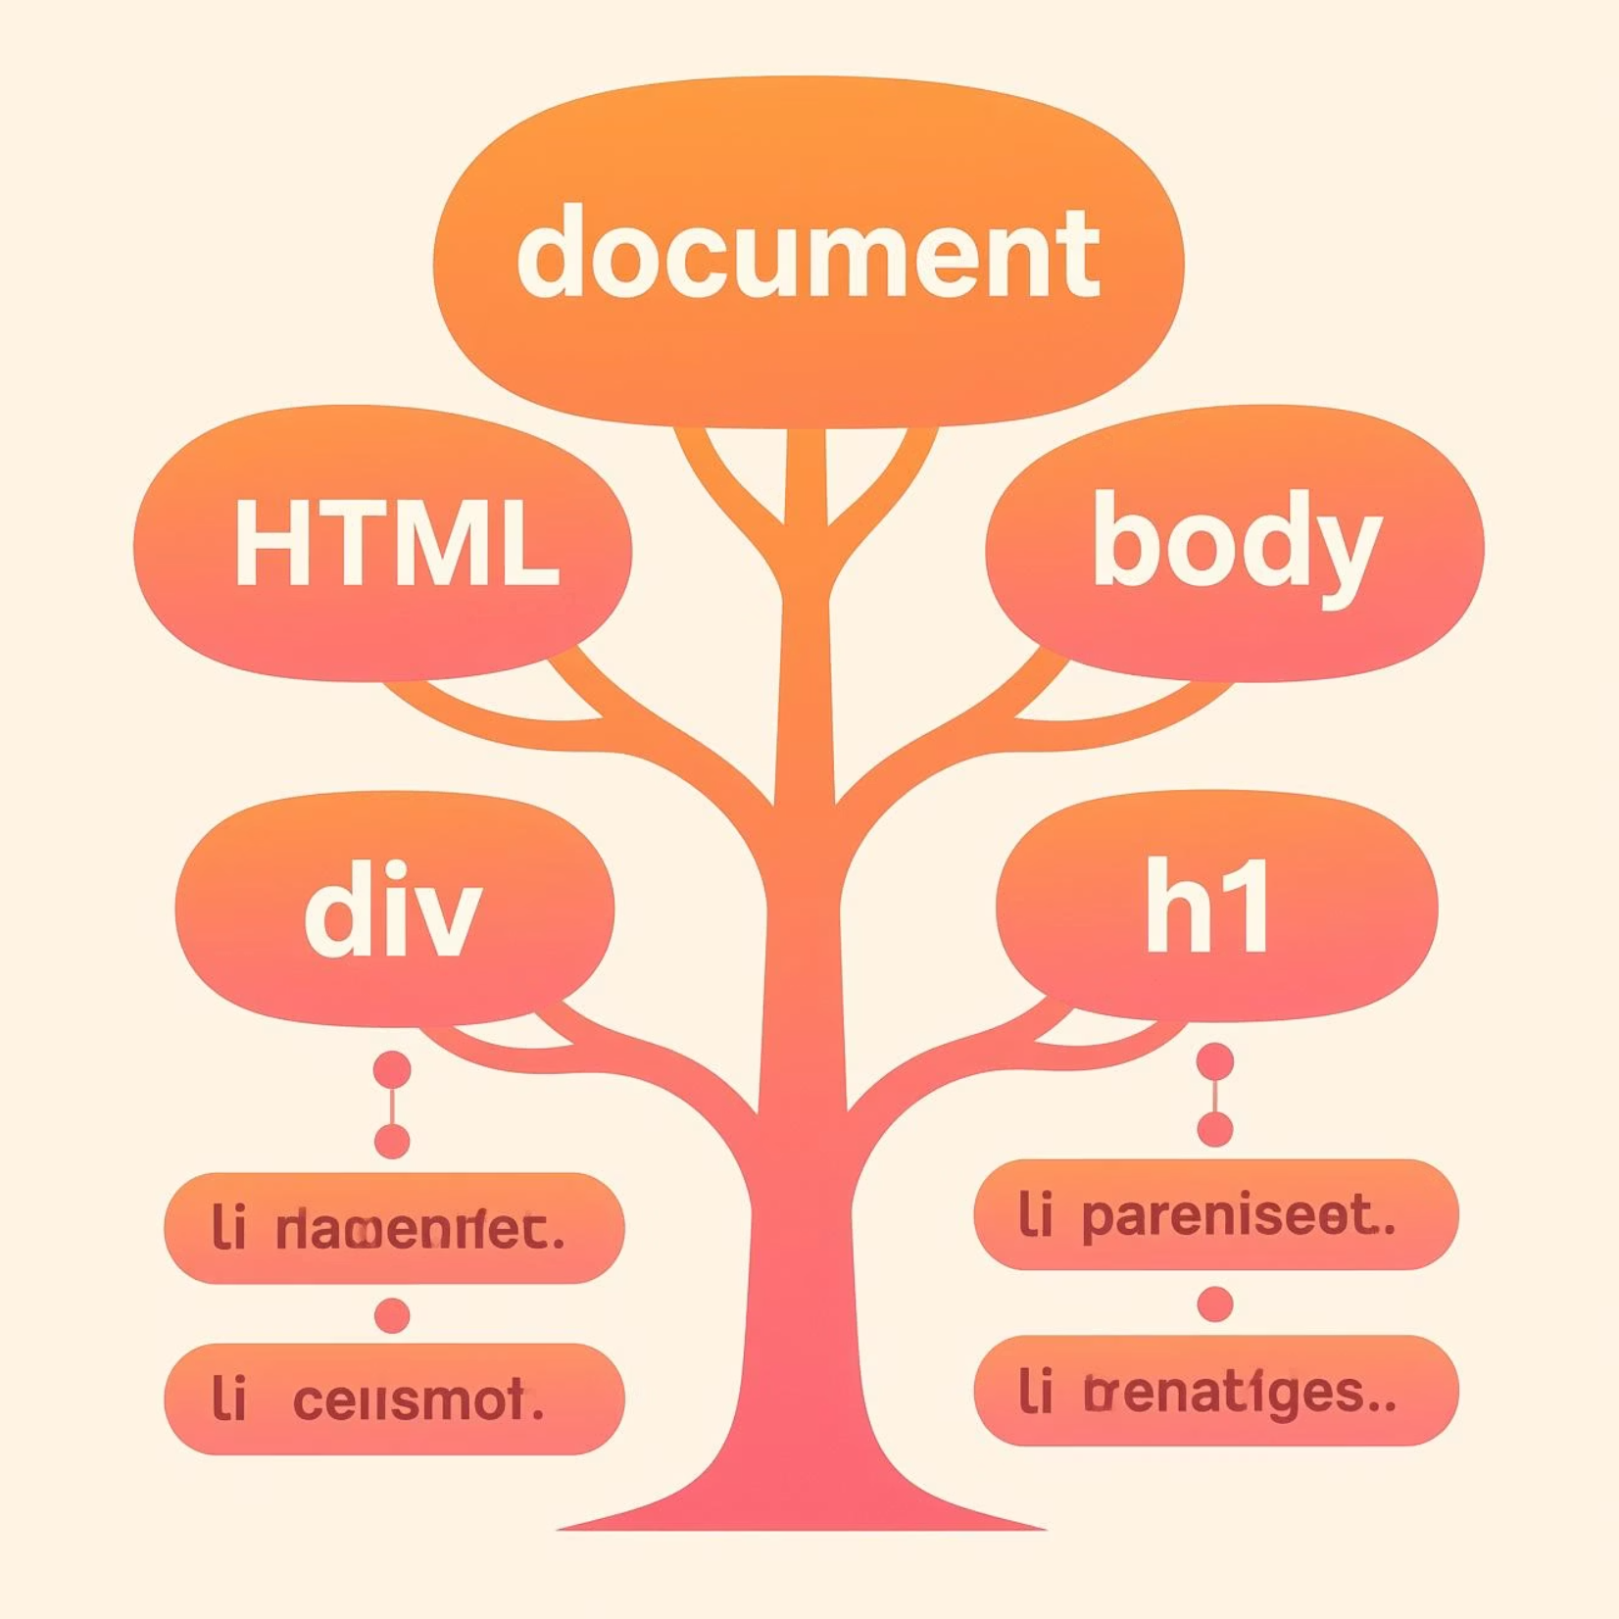
Visualizing the DOM Tree Structure
The DOM models the page as a hierarchy, creating a clear relationship between different parts of your HTML document:
Parent Nodes
Child Nodes
Sibling Nodes
For instance, a <div> element can contain child nodes like <h1>, <ul>, and even plain text nodes. Each node has a specific type:
Element nodes (e.g., <p>, <a>)
Text nodes (the actual content within elements)
Attribute nodes (properties of elements like href or src)

Slide 22
Key DOM Properties
DOM nodes expose various properties that allow JavaScript to inspect and modify their characteristics and content. Understanding these properties is crucial for effective DOM manipulation.
nodeName
childNodes
parentNode
Returns the name of the node (e.g., "DIV", "P" for element nodes, "#text" for text nodes, "#comment" for comment nodes).
A read-only collection (NodeList) of all child nodes of a given element, including text nodes and comment nodes.
Returns the parent node of the specified node in the DOM tree, allowing for upward traversal.
innerHTML
style
Gets or sets the HTML content (including tags) within an element, offering a powerful way to update content.
Provides direct access to modify the CSS inline styles of an element, enabling dynamic visual changes.

Slide 23


Hierarchical Structure in Action
The DOM's hierarchical nature allows developers to traverse and interact with elements in a structured manner. From selecting a specific element to adding new content dynamically, the tree model makes complex web manipulation intuitive.
Think of it like a family tree: each node has a parent, children, and possibly siblings. This relationship is key to understanding how elements are related on a webpage.

Slide 24
Essential DOM Methods for Element Access
These methods are your primary tools for selecting specific elements within the DOM tree:
document.getElementById(id)
document.getElementsByClassName(name)
document.getElementsByTagName(name)
Retrieves a single element using its unique id attribute. Ideal for direct access to specific page components.
Returns a live HTMLCollection of all elements sharing a specified class name. Great for grouping similar elements.
Provides a live HTMLCollection of all elements with a particular tag name, such as all <p> tags or <img> tags.
document.querySelector(selector)
document.querySelectorAll(selector)
Returns the first element that matches a specified CSS selector. Highly versatile for precise targeting.
Returns a static NodeList of all elements that match a specified CSS selector, offering robust selection capabilities.

Slide 25
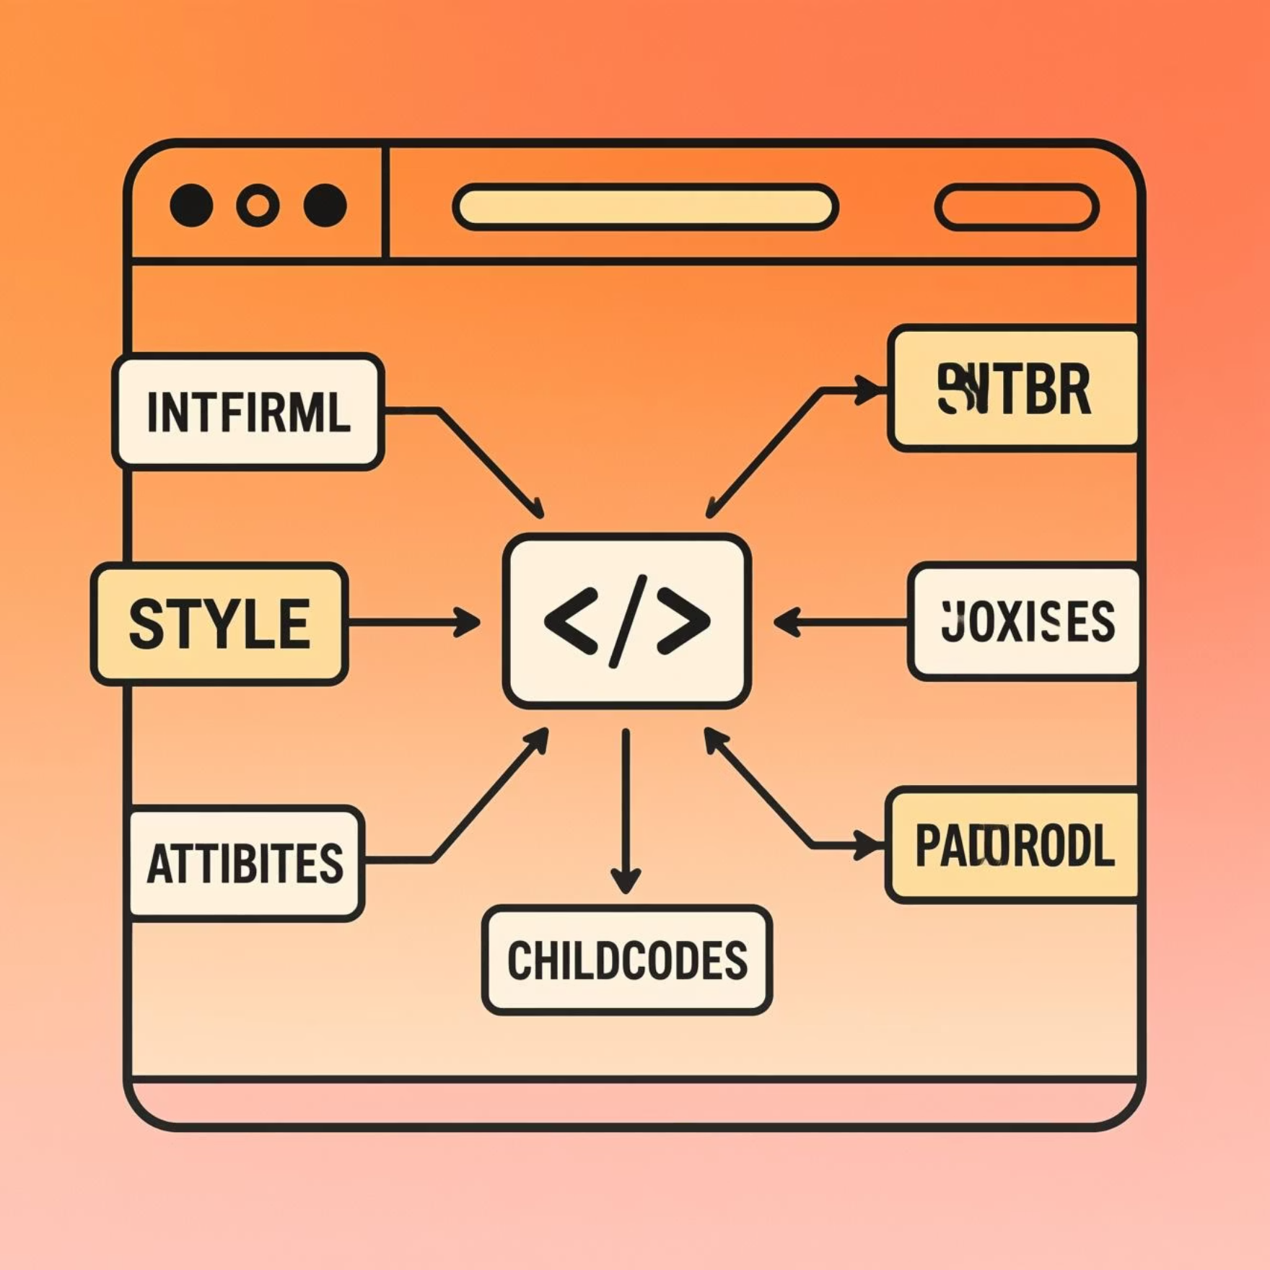
Common DOM Properties for Element Manipulation
element.innerHTML
DOM Tree Traversal Properties
Allows you to get or set the HTML content located inside an element. Perfect for dynamically updating text or adding new HTML.
element.parentNode: Access the immediate parent of an element.
element.childNodes: Get a NodeList of all direct children, including text and comment nodes.
element.style
element.firstChild: Access the very first child node of an element.
Provides direct access to modify the inline CSS styles of an element. Change colors, fonts, visibility, and more on the fly.
element.nextElementSibling / previousElementSibling: Navigate to sibling elements.
element.attributes
An object representing all attributes of an element. Use methods like getAttribute() and setAttribute() to read or change them (e.g., src for images, href for links).

Slide 26
Why Master the DOM?
Dynamic Web Pages
Foundation for Innovation
Instant Impact
Enables creation of rich, interactive web pages by changing content, styles, and structure in real-time, responding to user actions or data changes.
It's the bedrock for event handling, complex animations, and the backbone of modern front-end frameworks like React, Angular, and Vue.js.
With methods like document.getElementById("msg").innerHTML = "Hello, DOM!";, you can instantly update visible content on the page.
Start experimenting with these powerful methods and properties today to unlock your full potential in web development!

Slide 27

JavaScript Forms: Events, Methods, and Actions
Explore how JavaScript enhances web forms, enabling dynamic interactions and robust data handling through powerful events, methods, and actions.

Slide 28

What Are JavaScript Form Events?
Events are signals fired by the browser when users interact with form elements. They are crucial for creating dynamic and responsive user experiences.
1
2
onsubmit
onchange
Triggered when a form is submitted, ideal for final validation.
Fires when a form input's value is altered and then the element loses focus.
3
4
oninput
onreset
Triggered immediately as input changes, enabling real-time feedback.
Activated when a form is reset, useful for cleanup or confirmation.
These events empower developers to implement validation, dynamic feedback, and interactive user experiences, ensuring data integrity and user satisfaction.

Slide 29
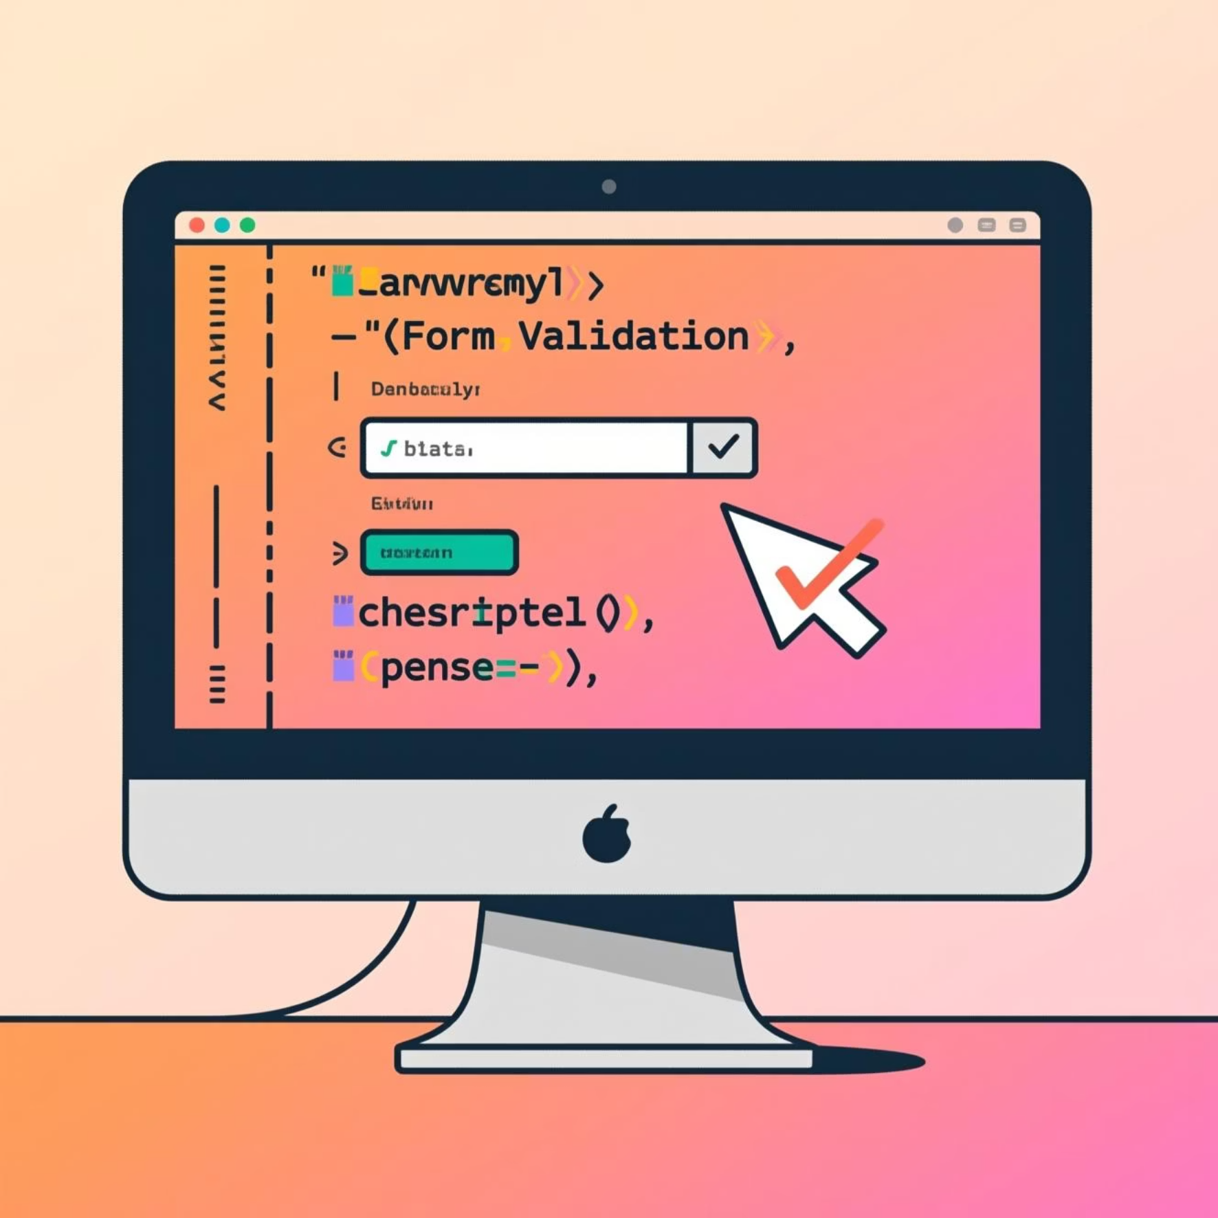
Handling Form Events: Practical Examples
onsubmit Event
The onsubmit event is essential for validating form fields before data submission. It allows you to intercept the submission process and prevent it if validation rules aren't met, using event.preventDefault().
onchange Event
The onchange event is perfect for dynamic UI updates, such as altering content based on a dropdown selection or recalculating values after an input field is modified.
Code Snippet Example
<form onsubmit="return validateForm()"> <input type="text" id="username" onchange="checkUsername()"> <!-- more fields --> <button type="submit">Submit</button> </form> <script> function validateForm() { // Validation logic here return true; // or false to prevent submission } function checkUsername() { // Dynamic check here } </script>

